Slide 1

Unit 14

Slide 2

Unit 14
I remember meeting
all of you in Grade 7.

Slide 3



Slide 4


To learn to share past memories and
experiences with your classmates.
To learn to use the sentence patterns:
I remember doing …
I have …

Slide 5


Junior high school days will soon be over.
Do you have any special memories at junior high school?

Slide 6
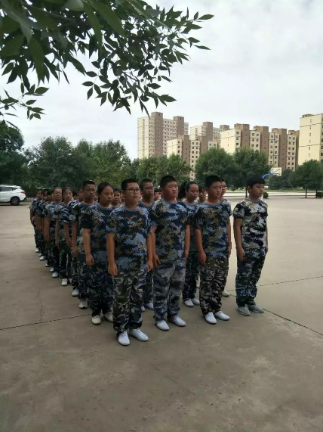
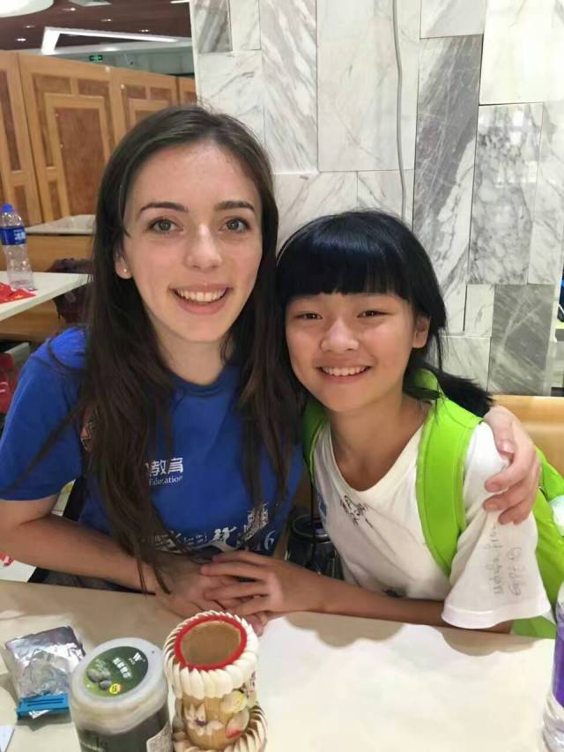
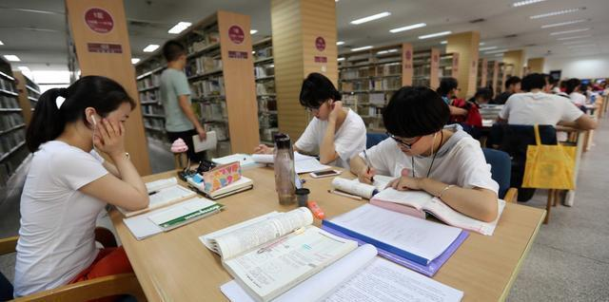
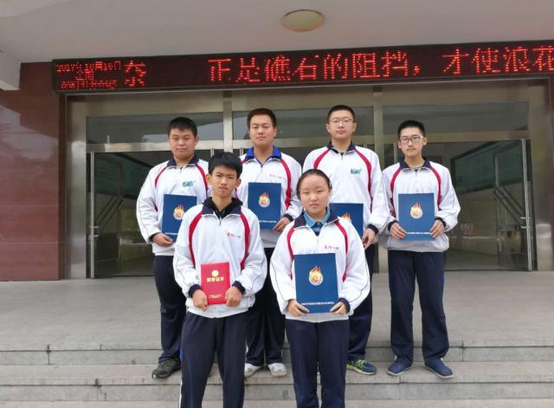
having military training in Grade 7
making new friends
reading in the morning
winning a prize

Slide 7
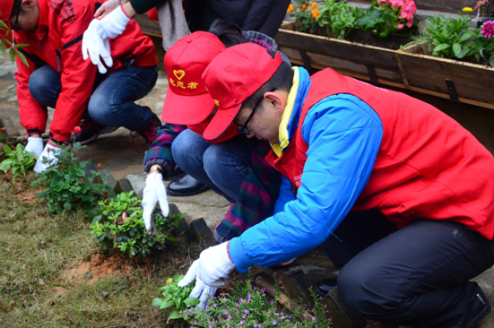
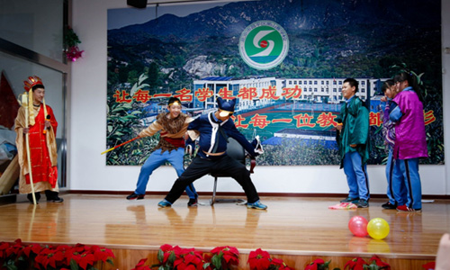
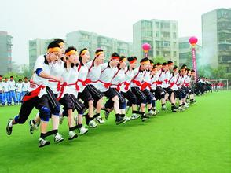
being volunteers to help others
putting on a play
having an interesting P.E. lesson

Slide 8
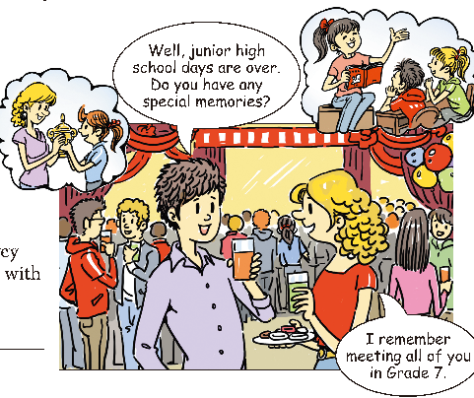

Look at the picture. What kind of party do you think it is? Is it a welcome party or a graduation party?

Slide 9
Look at the small pictures. What are the boy and the girl talking about? What does the girl remember doing? What do you remember doing in junior high school?

Slide 10

Check (√) the things you remember doing at junior high school. Add more to the list.
1a
At junior high school,
I remember:
____ winning a prize
____ being a volunteer
____ doing a school survey
____ a friend helping me
with a problem
n. 调查
preparing for art festival, helping each other with homework, …

Slide 11



Listen and match the memory with the person.
1b
____ Mary | a. did homework carefully to meet the standards of a strict teacher
____ Frank | b. remembers losing a schoolbag
____ Sarah | c. remembers meeting this group of friends
____ Peter | d. has enjoyed every year of junior high school
b.
n. 标准; 水平
d.
c.
a.

Slide 12
Listen and answer the questions.
1. What did Mary lose in Grade 7?
2. Who helped Mary to find her schoolbag?
3. What kind of person is Mr. Brown? Is he strict with students?
She lost her schoolbag in Grade 7.
Peter.
He is strict.

Slide 13
4. How did Peter feel about him?
5. What did Peter do to meet Mr. Brown’s
standards?
He was scared of him.
He always did his homework carefully.

Slide 14
Listen and complete the conversation.
Mary: Hey, Frank! Peter, Sarah and I were
just _______________ of junior high
school.
Frank: Great! Do you have any _______
memories, Mary?
Mary: Oh yeah, lots…I remember losing my
_________ in Grade 7.
Frank: I remember that! We all helped you
to ________ it, remember?
Mary: Yes, and Peter found it. Thanks for
____________ that day!
sharing memories
special
schoolbag
look for
saving my life

Slide 15
Peter: No problem!
Mary: How about you, Peter? What do you
remember?
Peter: Hmm…I ________ scared of Mr. Brown in
Grade 8. He was so ______! I always did my
homework carefully to meet his _________.
Sarah: Me, too. And I remember meeting all
of you in Grade 7 and we’ve been good
friends _________, haven’t we, Frank?
Frank: Yeah! I’ve enjoyed every year of
__________ school.
Peter: And we’re all going to ______ this place.
used to be
strict
standards
ever since
junior high
miss

Slide 16

remember to do sth.与remember doing sth.
remember ______ sth.表示“记得去做某事”,
说明事情还没有做；
remember _______ sth. 表示“记得做过某事”，说明事情已经做了。
【语境应用】用所给动词适当形式填空。
1) Remember ________ (call) us when you
get there.
2) I remember _______ (tell) you about it once.
to do
doing
to call
telling

Slide 17


Slide 18

List some memories and experiences from junior high school. Share your lists with your partner.
1c
Memories and experiences
I remember ... scoring two goals in a row during a soccer competition. ________________________________________________________________________________________________________________________
n. 一排; 一列; 一行
连续几次地
winning a basketball competition.
putting a plastic snake into a classmate’s desk.
getting a wish card on birthday.

Slide 19
I have ... learned to play the keyboard in music class. ____________________________________________________________________________
n. 键盘式电子乐器; 键盘
learned to sing many English songs.
learned to play basketball with my friends.

Slide 20



Listen to the conversation. Check (√) the facts you hear.
2a
______ Someone didn’t like P.E.
______ Someone was advised to take a
break from running by a teacher.
______ Someone had a health problem.
______ Someone joined the school band.
______ Someone liked Mr. Hunt’s teaching
methods.
n. 方法; 措施

Slide 21

Listen again. Match each question with the name of the person.
2b
Question | Answer
____ 1. Who wants to study medicine? | a. Luke
____ 2. Who told someone to take a break from runnning? | b. Brian
____ 3. Who hurt his or her knee? | c. Mr. Hunt
____ 4. Who thinks the That’s Life concert is the best memory? | d. Lisa
d
c
b
a

Slide 22
Listen again and fill in the blanks.
Lisa remembers they had a great _____ teacher. He gave clear ___________ and he was _____, too. Luke remembers when That’s Life _______ at school. They wrote a _____ to the band and the band _______ to come.
Junior high has been ____.
P.E.
instructions
kind
n.指示；命令
played
letter
offered
fun

Slide 23
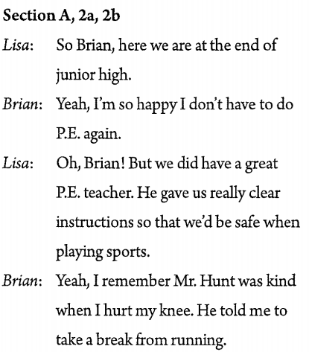
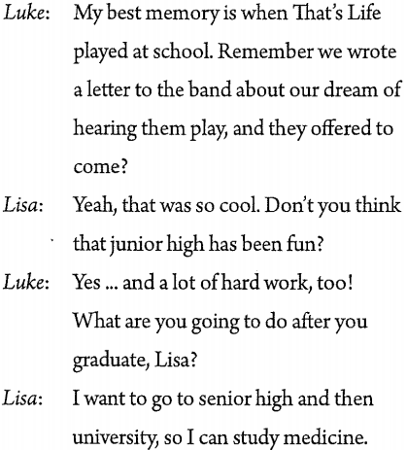

Listen again then role play.

Slide 24
Role-play a conversation in your
group using the information in 2a and 2b.
2c
Do you
remember
Mr. Hunt?
Of course! He’s a great teacher.
He gave really clear instructions
during P.E. class.
Yeah, he was kind when I hurt my knee. He told me to take a break from running.

Slide 25
My best memory is when That’s Life played at school. Remember we wrote a letter to the band about our dream of hearing them play, and they offered to come?
Do you
have any special memories?
Yeah, that was so cool.

Slide 26

Which teachers will you miss the most after junior high school?
What kind of teachers do you like?

Slide 27
Read the conversation and complete the chart.
2d
Student | Miss who | What subject | Why
Clara
Judy
patient, helped her to work out the answers
Ms. Lee
math
took the time to explain things clearly
Mr. Brown
science
Ms. Griffin
encouraged her a lot
English

Slide 28
Fill in the blanks.
Judy and Clara are talking about their junior high school life. Clara says she will miss Ms. Lee and Mr. Brown the most because Ms. Lee _____ always ___________ her in math class. And Mr. Brown always _____ the time __________ things to her clearly ________ she couldn’t understand anything. Judy will miss Ms. Griffin because she encouraged her in English class, and Judy’s exam ______ doubled. They will _____ each of the teachers a card and gift to say thank you.
was
patient with
took
to explain
whenever
scores
get

Slide 29


Slide 30

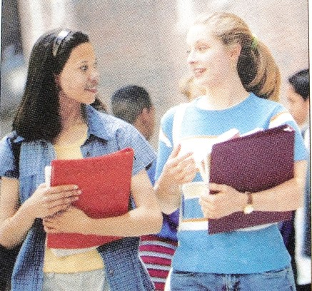
Which teachers will you miss the most after junior high school, Clara? …
Ms. Lee and Mr. Brown…

Slide 31


获奖
做一项调查
连续地
加入学校乐队
教学方法
明确的指示
对某人有耐心
计算出答案
给某人解释某事
因为
付出更多的努力
win a prize
do a survey
in a row
join the school band
teaching method
clear instructions
be patient with sb.
work out the answers
explain sth. to sb.
because of
put in more effort

Slide 32


Ⅰ. 根据句意，从方框中选择恰当的单词填
空，有的需要变换形式。
survey, keyboard, double, instruction, shall, standard
1. The number of cars on the roads has
__________ over the past few years in my city.
2. __________ I invite my math teacher to the
birthday party, Mom?
doubled
Shall

Slide 33
survey, keyboard, double, instruction, shall, standard
survey
3. According to a recent __________, 90 percent
of people like this TV play.
4. Miss Mills made the __________ simple so
that the children could understand them.
instructions

Slide 34
survey, keyboard, double, instruction, shall, standard
5. Without doubt, the living __________ in the
small village has improved a lot since 2000.
6. Paul has much experience playing the
__________. He began to learn it at the age of
6.
standard
keyboard

Slide 35
Ⅱ. 根据句意及汉语提示，完成下列句子。
1. Have you __________ __________(计算出)
how much these things will cost?
2. Bob told me he didn’t want to make two
mistakes __________ _________ __________
(连续).
3. Susan enjoys music very much. She
__________ __________ __________
__________(加入学校乐队) two years ago.
worked out
in a row
joined the school
band

Slide 36
4. Judy, we have been walking along the river
for an hour. What about __________
__________ __________(休息一下)?
5. In big cities, cars and buses have polluted
the air. A lot of people__________
__________ __________(健康有问题).
6. The English teacher used a new __________
__________(教学方法). As a result, the
students became more interested in the
lessons.
taking
a break
have
health problems
teaching
method

Slide 37
Ⅲ. 根据汉语意思及括号内所给英文提示语，
将下列句子翻译成英语。
1. 王老师对她的学生们有耐心。 (patient)
______________________________________
2. 谁指导你读这本书的？ (guide)
______________________________________
3. 向小孩解释这个问题很难。 (explain)
______________________________________
______________________________________
Miss Wang is patient with her students.
Who guided you to read the book?
It is difficult to explain the problem to children.

Slide 38
4. 因为下雨，昨天他们不得不待在家。
(because of)
_____________________________________
_____________________________________
5. 莫莉(Molly)经常花时间在养老院帮助做一
些事情。 (take)
_____________________________________
_____________________________________
They had to stay at home yesterday because of the rain.
Molly often takes time to help do something in the old people's home.

Slide 39


1. Share your past memories and experiences from junior high school in 70 words.
2. Recite the conversation in 2d.
3. Preview the article on page 107.

Slide 40


